Slide 1
CSCE 120/121
Linked Lists
Notes:
CONCEPT: Dynamically allocated data structures may be linked together in memory to form a chain.

Slide 2
Introduction
In the most generic sense, a list is simply a finite sequence of elements
More appropriately, it is a storage structure for a finite sequence of elements
An array is one example of a list
BUT
Arrays tend to be inflexible
Usually need to know the maximum size that is ever needed
But that’s hard to guarantee
Can easily waste storage if not fully utilized

Slide 3
Nodes
This is where we are going to really put pointers and dynamic memory to work
Pointer variables are often part of a structure called a node
The node has two parts:
Information, or data, and
A pointer to another node
data
0x2A46
data
(Pointer)
0x928C
0x2A46

Slide 4
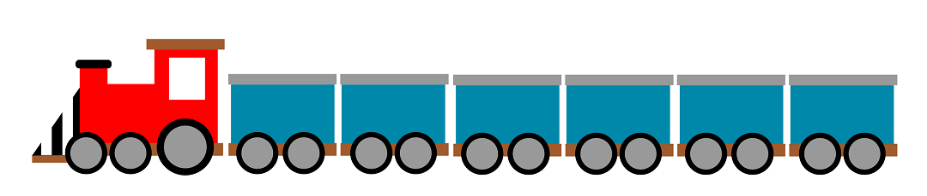
Linked Lists
Another way to organize data items
Place them within objects—usually called nodes
Linked together into a “chain,” one after the other
Kind of like a freight train
Image from freesvg.org
Notes:
A linked list is a series of connected nodes, where each node is a data structure. A linked list can grow or shrink in size as the program runs. This is possible because the nodes in a linked list are dynamically allocated. If new data need to be added to a linked list, the program simply allocates another node and inserts it into the series. If a particular piece of data needs to be removed from the linked list, the program deletes the node containing that data.

Slide 5
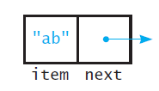
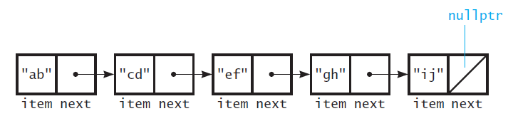
Linked Lists
A node, with a string as the data item
Several nodes linked together to form a linked list
This and most subsequent list diagrams are modified from Data Abstraction and Problem Solving with Java, by Carrano and Prichard
Notes:
This slide depicts the nodes in the linked list as being very close to each other, neatly arranged in a row.
In reality, the nodes may be scattered around various parts of memory.

Slide 6
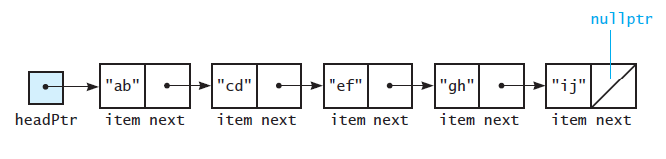
Linked Lists
There is also a special pointer, called the head pointer.
It points to the first node in the list
The last node in the list contains the null pointer in its next field.
A head pointer to the first of several linked nodes

Slide 7
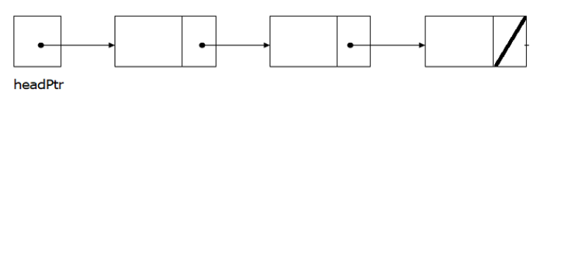
Linked Lists vs. Arrays and Vectors
Linked lists can grow and shrink as needed, unlike arrays, which have a fixed size
Linked lists can insert a node between other nodes easily
Notes:
Although linked lists are more complex to code and manage than arrays, they have some distinct advantages. First, a linked list can easily grow or shrink in size. In fact, the programmer doesn’t need to know how many nodes will be in the list. They are simply created in memory as they are needed.
One might argue that linked lists are not superior to vectors, because vectors, too, can expand or shrink. The advantage that linked lists have over vectors, however, is the speed at which a node may be inserted into or deleted from the list. To insert a value into the middle of a vector requires all the elements below the insertion point to be moved one position toward the vector’s end, thus making room for the new value. Likewise, removing a value from a vector requires all the elements below the removal point to be moved one position toward the vector ’s beginning. When a node is inserted into or deleted from a linked list, none of the other nodes have to be moved.

Slide 8
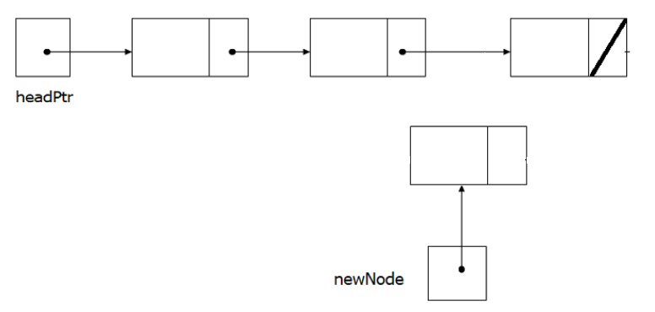
Linked Lists vs. Arrays and Vectors (2)
Linked lists can grow and shrink as needed, unlike arrays, which have a fixed size
Linked lists can insert a node between other nodes easily
Create a new node with the data you want
2. Link the new node to the rest of the list
Notes:
To insert a data, first create a new node with the data you want.
Then, link the new node to the rest of the list by copying the pointer out of the link field of the previous node.

Slide 9
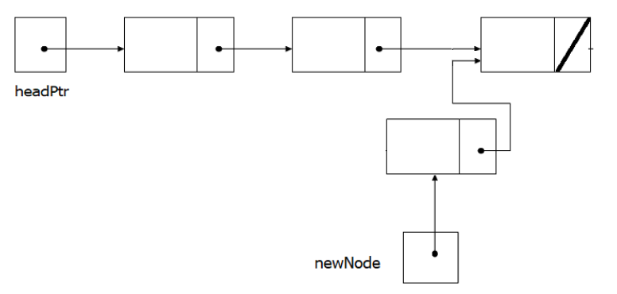
Linked Lists vs. Arrays and Vectors (3)
Linked lists can grow and shrink as needed, unlike arrays, which have a fixed size
Linked lists can insert a node between other nodes easily
Create a new node with the data you want
Link the new node to the rest of the list
3. Link the previous node to the new node
Notes:
Like this
Then link the previous node to the new node by updating the link field of the previous node

Slide 10
Linked Lists vs. Arrays and Vectors (4)
Linked lists can grow and shrink as needed, unlike arrays, which have a fixed size
Linked lists can insert a node between other nodes easily
Create a new node with the data you want
Link the new node to the rest of the list
Link the previous node to the new node
Notes:
Like this, and now the new data has been successfully added.

Slide 11
Empty List
If a list currently contains 0 nodes, the list still exists
It is the empty list
In this case the head pointer is the nullptr
Notes:
If a list currently contains 0 nodes, the list still exists
It is the empty list
In this case the head pointer is the nullptr
If the head is null, the list is empty, but it still exists.

Slide 12
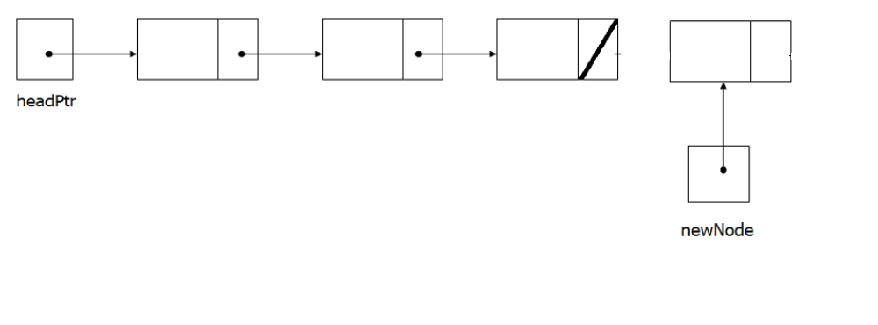
Special Cases?
What about inserting a node at the end of a linked list?
Is that a special case?
Create a new node with the data you want
Notes:
Let’s look at some special cases…. What about inserting a node at the end of a linked list?
Is that a special case? Let’s see….
First we create a node containing the data you want, just like before.

Slide 13
Special Cases? (2)
What about inserting a node at the end of a linked list?
Is that a special case?
Create a new node with the data you want
2. Link the new node to the rest of the list (which is empty.
Notes:
Then, link the new node to the rest of the list by copying the pointer out of the link field of the previous node, just like we did before.
It’s a null pointer, but that’s what we want – the rest of the list is the empty list.

Slide 14
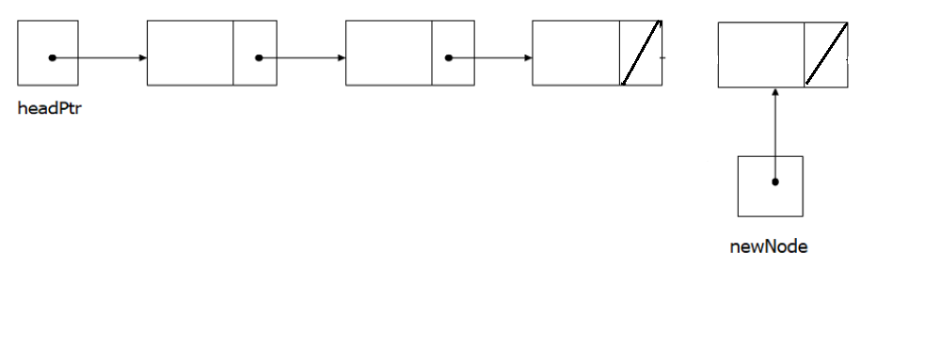
Special Cases? (3)
What about inserting a node at the end of a linked list?
Is that a special case?
Create a new node with the data you want
Link the new node to the rest of the list
Notes:
Then link the previous node to the new node by updating the link field of the previous node like we did before.

Slide 15

Special Cases? (4)
What about inserting a node at the end of a linked list?
Is that a special case?
So, no, it’s not a special case.
Create a new node with the data you want
Link the new node to the rest of the list
Link the previous node to the new node
Notes:
So we are done, and no, it’s not a special case.

Slide 16
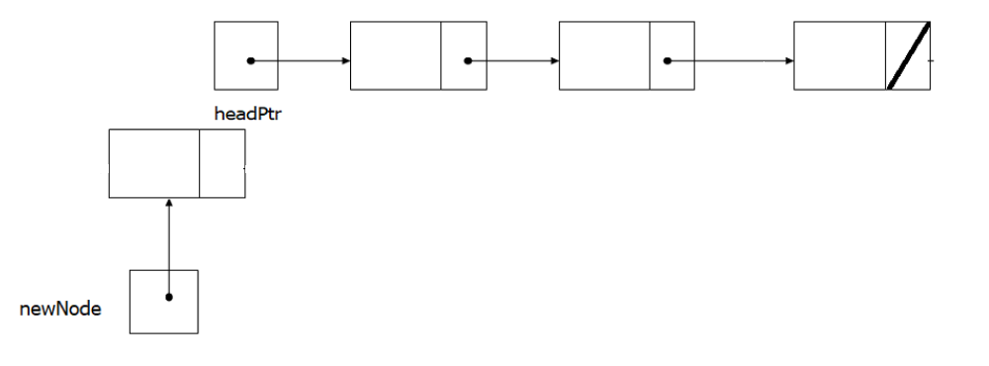
Special Cases? (5)
What about inserting a node at the beginning of a linked list?
Is that a special case?
Copy the head pointer into the next field of the new node
Notes:
What about inserting a node at the beginning of a linked list?
Is that a special case?
Like before, we first create a new node with the data you want.
Then, Copy the head pointer into the next field of the new node

Slide 17
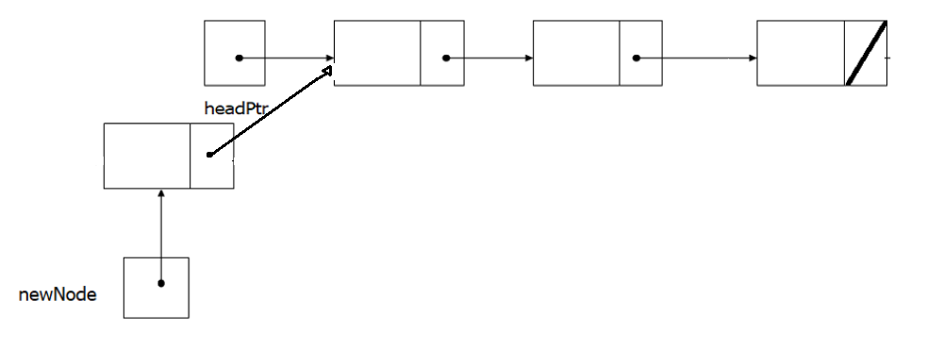
Special Cases? (6)
What about inserting a node at the beginning of a linked list?
Is that a special case?
Copy the head pointer into the next field of the new node
2. Copy newNode into the headPtr
Notes:
Next, we copy the pointer to the new node into the head pointer.

Slide 18
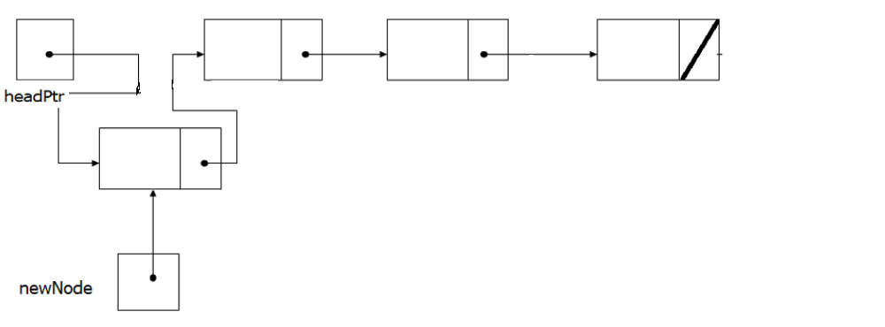
Special Cases? (7)
What about inserting a node at the beginning of a linked list?
Is that a special case?
So, yes, it’s a special case.
Copy the head pointer into the next field of the new node
2. Copy newNode into the headPtr
3. We have to change the headPtr
Notes:
Like this.
We’ve changed the head pointer.
So, yes, it is a special case..

Slide 19
Deleting a Node
Used to remove a node from a linked list
If list uses dynamic memory, then delete node from memory
Requires two pointers: one to locate the node to be deleted, one to point to the node before the node to be deleted
Notes:
Deleting a node from a linked list requires two steps:
1. Remove the node from the list without breaking the links created by the next pointers.
2. Delete the node from memory.
This Requires two pointers: one to locate the node to be deleted, one to point to the node before the node to be deleted

Slide 20
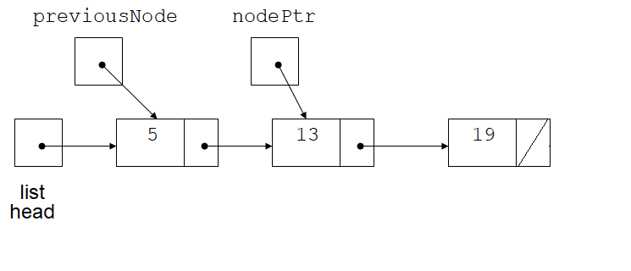
Deleting a Node (2)
headPtr
Locating the node containing 13
Notes:
Suppose we want to delete the node which contains 13.
We have to know what node comes before it in the linked list.
Call that node, “previousNode”.

Slide 21
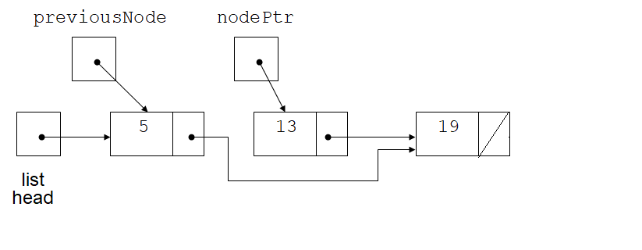
Deleting a Node (3)
headPtr
Adjusting pointer around the node to be deleted
Notes:
We have to make the next field of previousNode point to the node that comes after the node we want to delete.
We do that by copying the pointer out of the next field of the node we are going to delete.

Slide 22
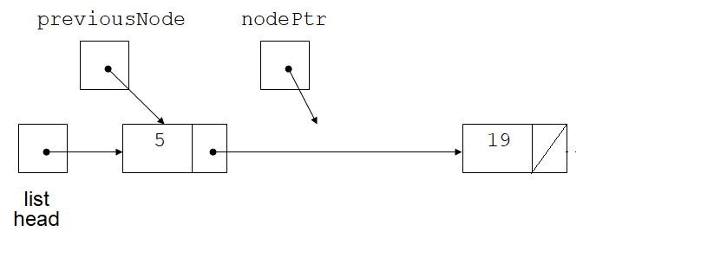
Deleting a Node (4)
headPtr
Linked list after deleting the node containing 13
Notes:
We delete the node.
But the nodePtr is still pointing to the deleted node.

Slide 23
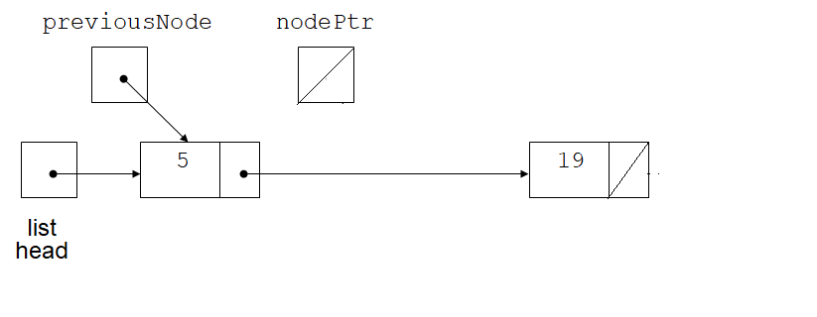
Deleting a Node
headPtr
Linked list after deleting the node containing 13
Notes:
So we also need to set nodePtr to the null pointer to complete the operation

Slide 24
Variations of the Linked List
Notes:
There are many ways to link dynamically allocated data structures together.
Two variations of the linked list are the doubly linked list and the circular linked list.

Slide 25
Variations of the Linked List (1)
Other linked list organizations:
doubly-linked list: each node contains two pointers: one to the next node in the list, one to the previous node in the list
5
13
19
NULL
list
head
headPtr
NULL
Notes:
In the doubly-linked list, each node contains two pointers: one to the next node in the list, one to the previous node in the list
Note that this makes it possible to move both forward and backward in the linked list.
.

Slide 26
Variations of the Linked List (2)
Other linked list organizations:
circular linked list: the last node in the list points back to the first node in the list, not to nullPtr
Note that the head can move
5
13
19
list
head
Notes:
In the circular list, instead of the last node containing the null pointer, it contains a pointer back to the first node in the list
Note that the head can move, so we typically call it the list pointer instead of the head pointer.
Out-tro
This has been an introduction to the concept of linked lists. Thanks for watching.

